Slide 1
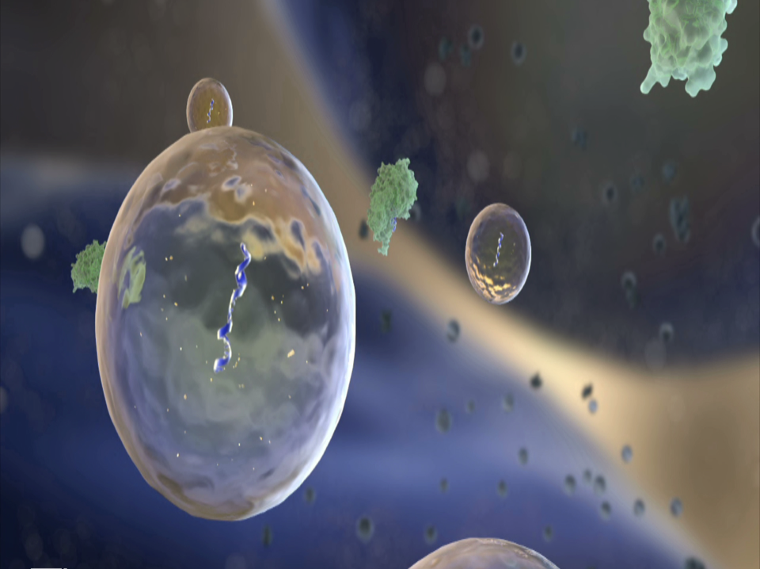
Stem cell derived Exosomes:
The Next Generation of Therapeutics

Slide 2
Mesenchymal stem cells
Antonio Icily et al, Nature Rev, 2008

Slide 3
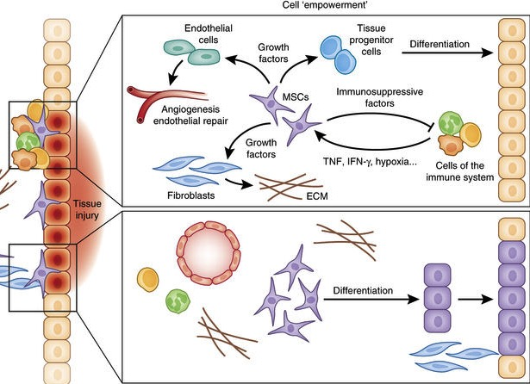
Current paradigm in MSC mechanism
Paracrine mechanism
Differentiation
Ying Wang et al, Nature Immunology, 2014

Slide 4

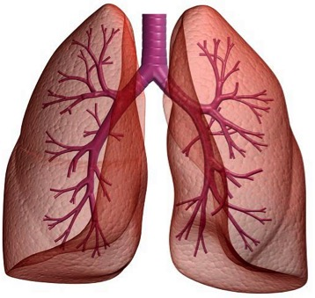
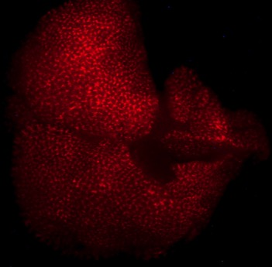
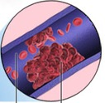
Pulmonary first pass effect: Infused stem cell are entrapped in lung
Stem Cells
DiR-Human MSC in mouse lung
Vesicles
Lung Capillaries

Slide 5
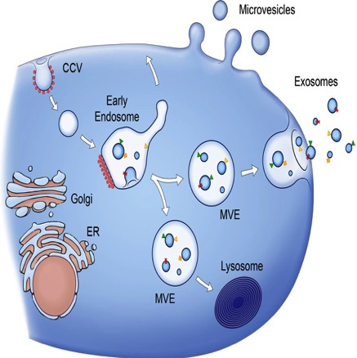
Sub-populations of of Extracellular Vesicles
Clotilde Thery at al, Nature reviews 2009

Slide 6
Discovery of transfer of RNA and protein

Slide 7
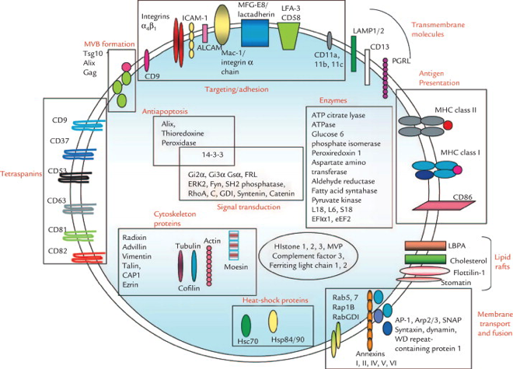
Composition of EVs
Peter Vader et al, Trends in Mol Med 2014

Slide 8
Different ways of EVs delivery
Michael Marcus et al, Pharmaceuticals 2013

Slide 9
Extracellular Vesicles applications
Clotilde Thery at al, Nature reviews 2009

Slide 10
Bidirectional talk between stem cells and injured cells
Endogeneous repair
Exogeneous repair

Slide 11
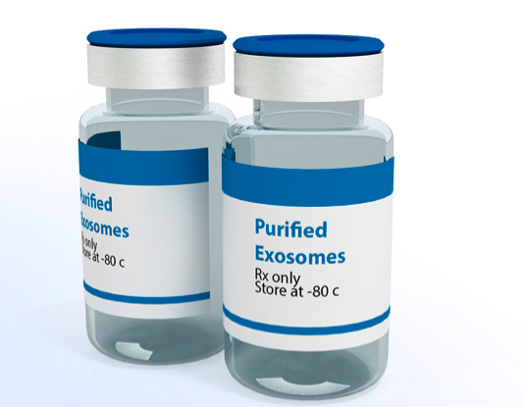
Compared to whole cells, exosomes have superior properties for therapy
No maldifferentiation
No tumor formation (Likely)
No entrapment in the lung
Superior tissue penetration
“Off the shelf” products
Easier cryohandling and stability
Riazifar et al. Annual Reviews in Pharmacology and Toxicology, 2017
Notes:
MPP: Multopotent progenitor cells. CMP: Common Myeloid Progenitor cells. CLP: Common Lymphoid progenitor, GMP: Granulocyte Macrophages progenitors,
MEP: Megakaryocyte Erythroid progenitor.

Slide 12
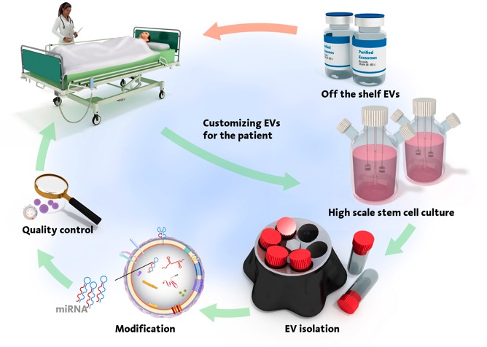
MSC EVs use in future

